Slide 1


FLUTTER
Campus Connect
A Digital Solution for Campus Event Management
NANDAKISHORE A
223143010016

Slide 2


Content
Introduction | 3
Objectives | 4
Existing System | 5
Proposed System | 6
Features Overview | 7
System Requirements | 9
DFD | 10
Implementation Screenshot | 13
Future Scope | 16
Conclusion | 17

Slide 3


Introduction
CampusConnect is a digital platform developed to simplify and automate event management in educational institutions. It allows students, faculty, and administrators to easily schedule events, send requests, and receive approvals—all in one place. By replacing manual paperwork with a streamlined process, CampusConnect saves time, improves communication, and ensures smoother coordination for campus activities.

Slide 4
Objective
✅ Primary Goal
To simplify event management in educational institutions by allowing students and faculty to easily schedule, request, and manage events and venue bookings through a single digital platform.
📌 Secondary Goals
Apart from the main goal, CampusConnect also aims to reduce the need for manual paperwork and speed up the event approval process. It helps improve communication between students, organizers, faculty, and staff, ensuring everyone is updated on event requests.

Slide 5

Existing System
Manual Form Collection & Submission: Event organizers must physically collect and submit forms to various departments, consuming time and effort.
Multiple Department Visits for Approval: Approval requires visiting faculty, HODs, principal, and admin staff in person.
No Centralized Venue Booking System: Venue availability isn't visible institution-wide, causing double bookings and scheduling conflicts.
No Real-Time Approval Tracking: There's no system to view the status of approvals; applicants rely on manual follow-ups.

Slide 6
Proposed System
Mobile-Based Platform: Accessible via smartphones, making it convenient for students, faculty, and admins.
Digital Event Request Submission: Students can submit event proposals online—no need for physical forms or office visits.
Real-Time Approval Updates: Users can instantly view the status of their event requests—whether Approved, Rejected, or Pending—directly within the platform.

Slide 7
Role-Based Access: Separate login and dashboards for students, faculty, and admins to manage responsibilities.
Reduced Delays and Miscommunication: By cutting down physical forms and manual approvals, decisions are faster and more transparent.
Expandable Functionality: CampusConnect is designed with expandable functionality to support future enhancements and integrations.

Slide 8
Features Overview
Online Event Scheduling: Easily book venues and schedule events through a user-friendly digital interface.
Automated Approval Workflow: Streamlines the approval process by routing requests to the right authorities instantly.
User-Friendly Interface: Designed with a clean, modern interface that ensures a smooth experience.

Slide 9
Event Records: Maintain a centralized and accessible log of all upcoming events scheduled through the CampusConnect for easy reference.
Dashboard Overview: Gives a clear summary of upcoming events, pending approvals, and booking status.
Conflict-Free Booking: Prevents double booking by showing available venues in real time.

Slide 10
🛠️ System Requirements
Tools Used
Software
Hardware
Flutter Sdk
Visual Studio
Firebase
Android 13 or higher
4GB RAM
100MB Space
Internet Connectivity

Slide 11
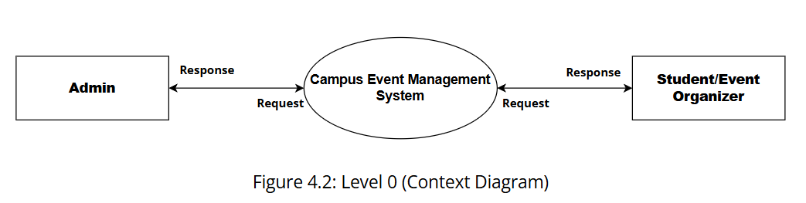
DFD Level 0

Slide 12
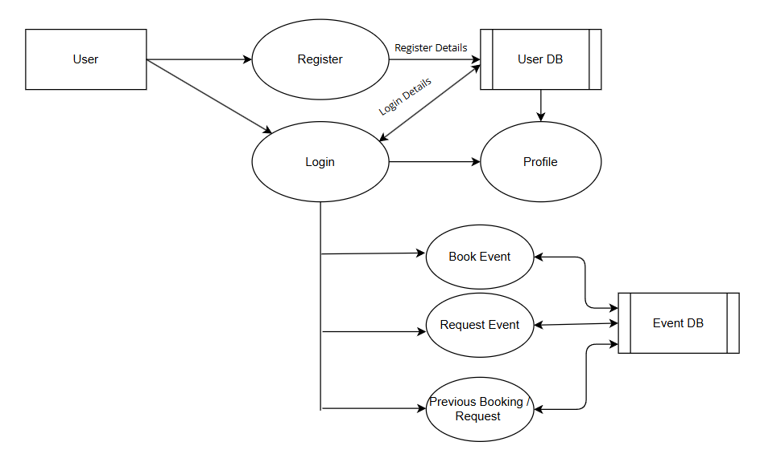
DFD Level 1: User

Slide 13
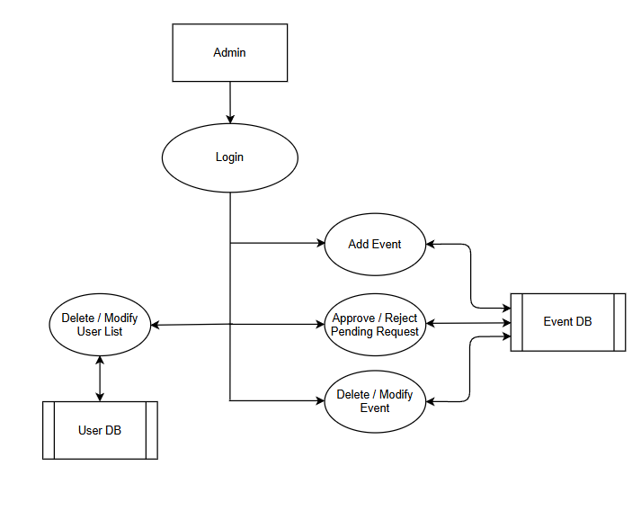
DFD Level 1: Admin

Slide 14

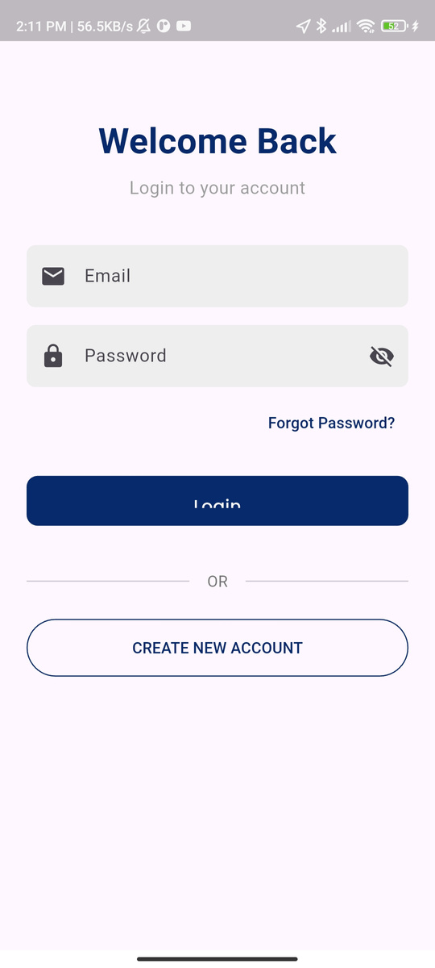
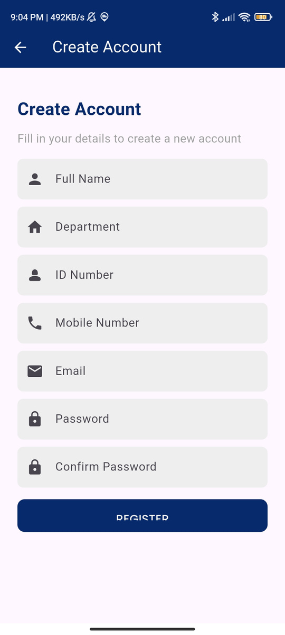
Implementation Screenshot
Login & Register Page

Slide 15
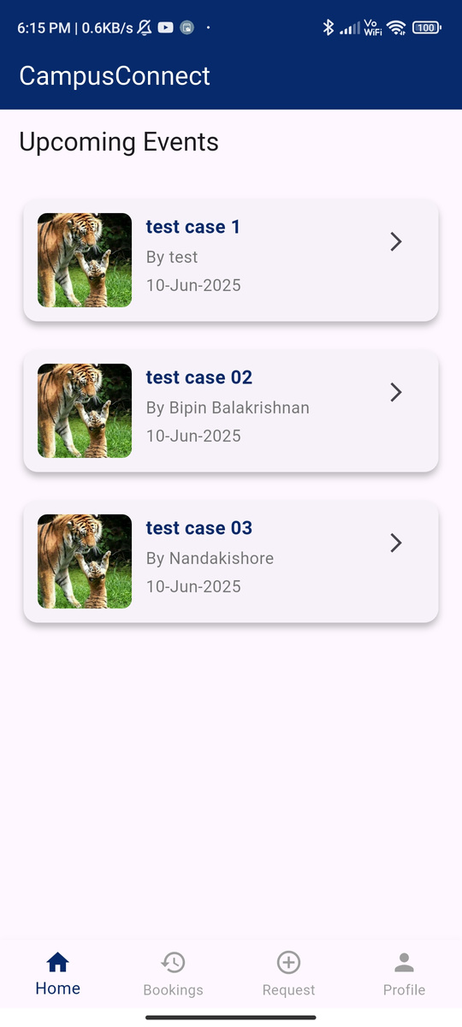
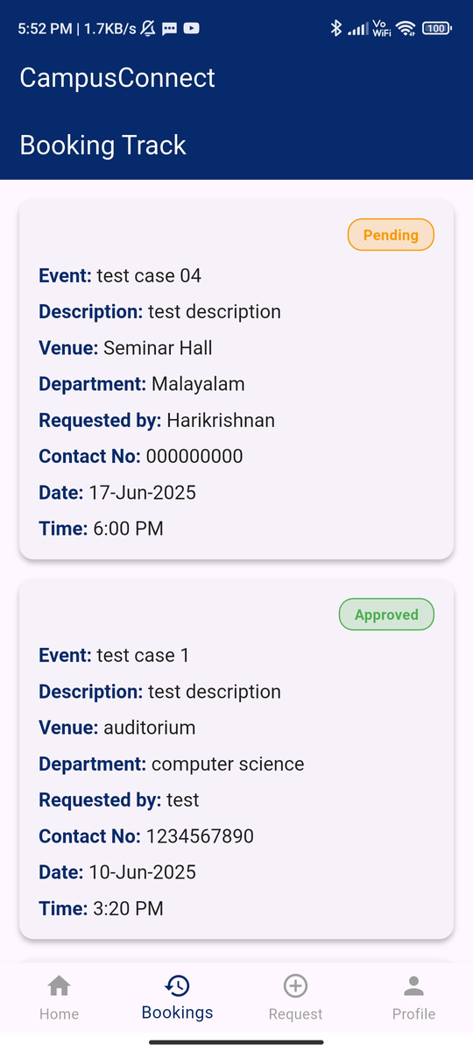
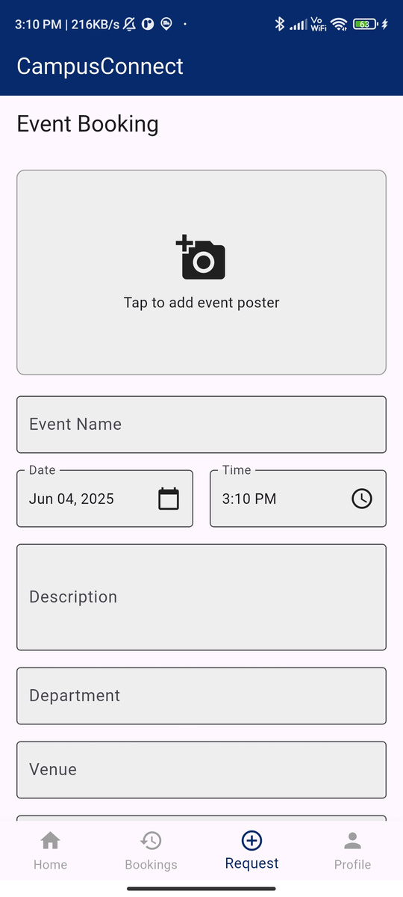
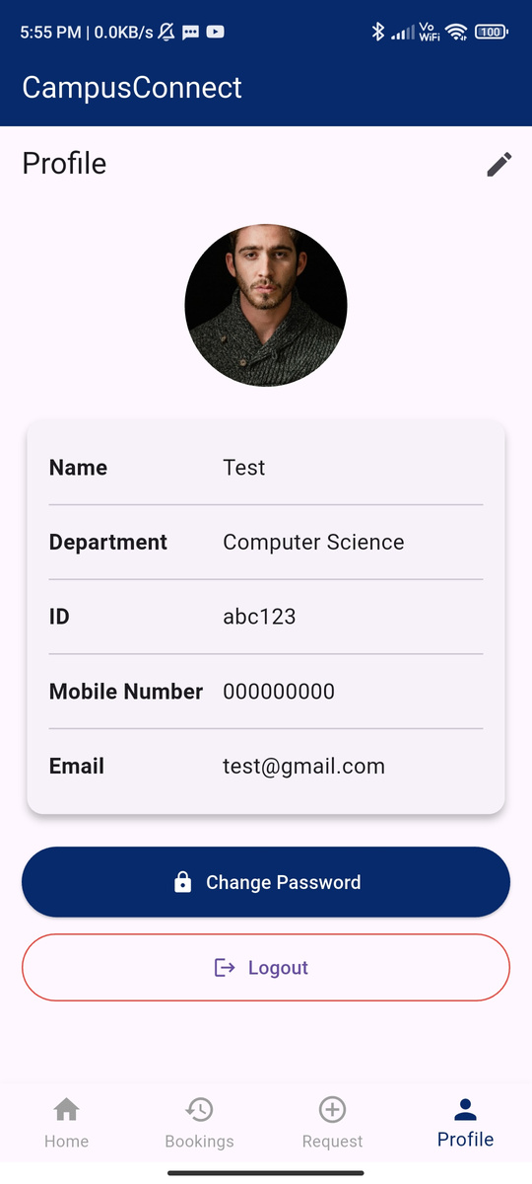
Homepage
Previous Booking / Previous Request
Event Request
Profile
Student / User

Slide 16
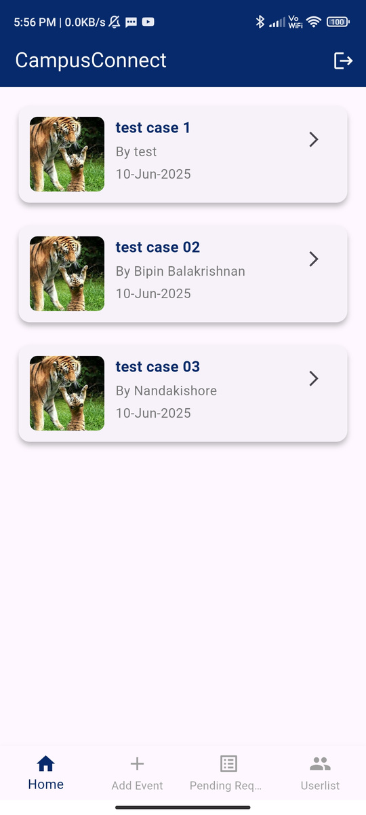
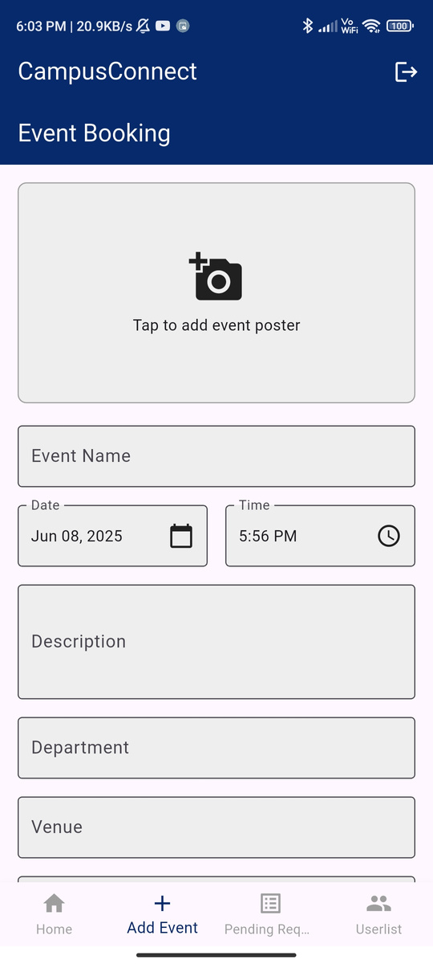
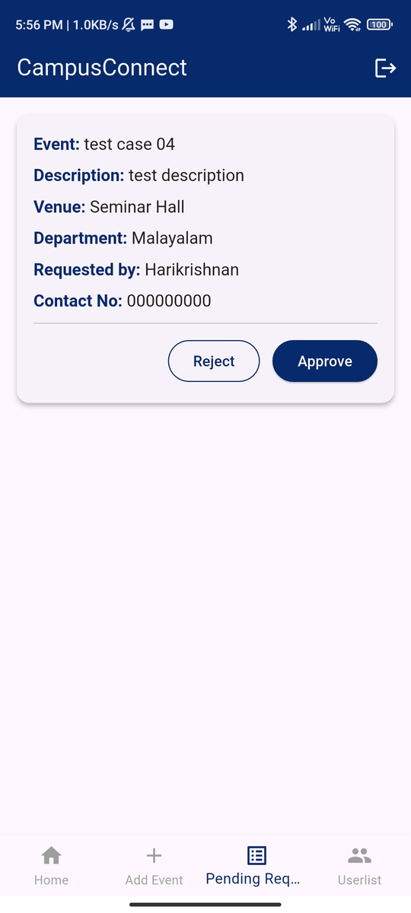
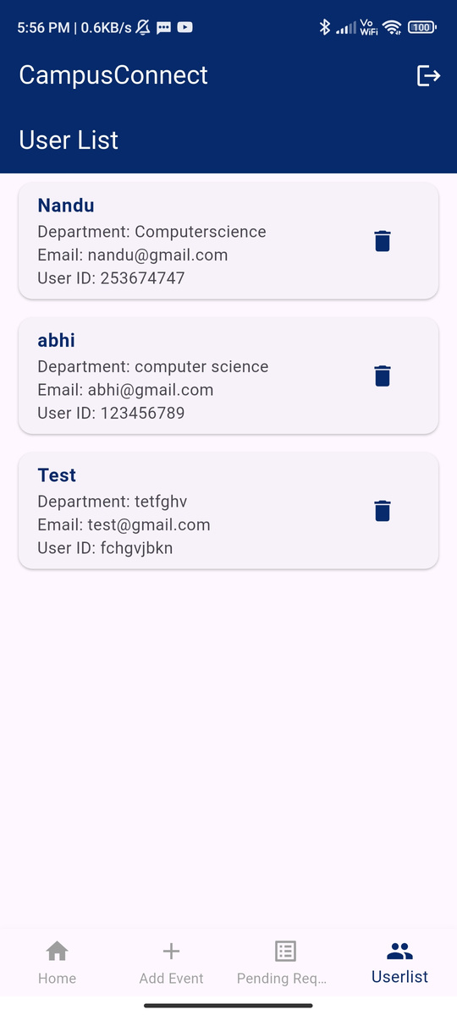
Homepage
Add Event
Pending Request
Userlist
Admin

Slide 17
Future Scope
To ensure that CampusConnect continues to evolve and adjust to the evolving demands of campus users, many possible enhancements are proposed:
1.QR Code-Based Event Check-In
Enables quick and secure attendance marking using QR scanning at the event venue.
2.Push Notifications
Personalized notifications based on interests can increase user engagement.
3.Event Participation Records
Maintain a record of students who booked or registered for each event.

Slide 18
Conclusion
CampusConnect is a powerful digital solution designed to simplify campus event management and boost engagement. With a user-friendly interface, real-time search, and smooth booking, it ensures an efficient user experience. Built using Flutter and Firebase, the app is stable, cross-platform, and scalable. Through continuous feedback and updates, CampusConnect will evolve to meet the growing needs of campus communities.

